Slide 1
Project Selection
Chapter 2, T1
M K Hamirwasia
WILPD

Slide 2
AE/DE/MM/ES/POM ZG523-Merged
Project Management
Lecture No. 04

Slide 3
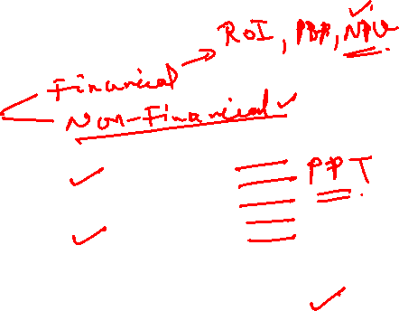
Design of a PORTFOLIO MANAGEMENT SYSTEM
Design of a Portfolio Management System should include:
  Classification of a Project
  Selection Criteria
  Sources of Proposals
  Evaluating Proposals
  Managing the Portfolio of Projects

Slide 4
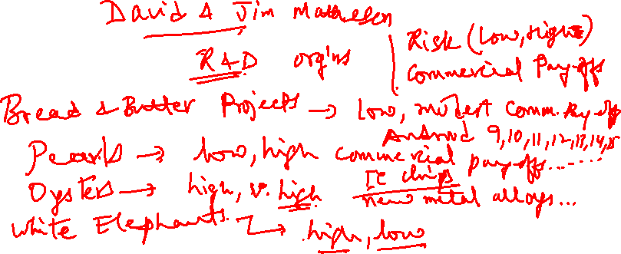

Slide 5
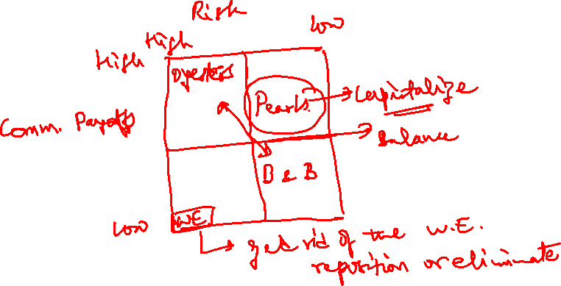

Slide 6
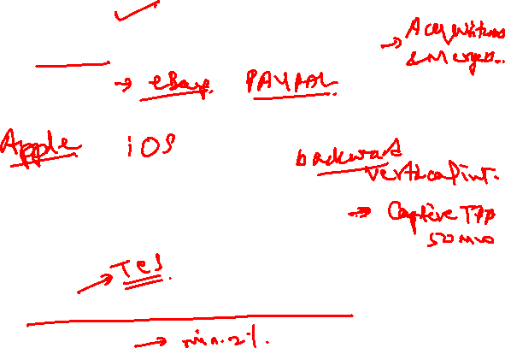
Non-Financial Criteria
Long-term Survival (developing and maintaining core competencies)
To capture larger market share
To make it difficult for competitors to enter the market
To develop an enabler product
To develop core technology that will be used in next-gen products
To reduce dependency on unreliable suppliers
To prevent government intervention and regulation
Less Tangible Criteria - Restore Corporate Image, Enhance Brand Recognition, CSR initiatives

Slide 7
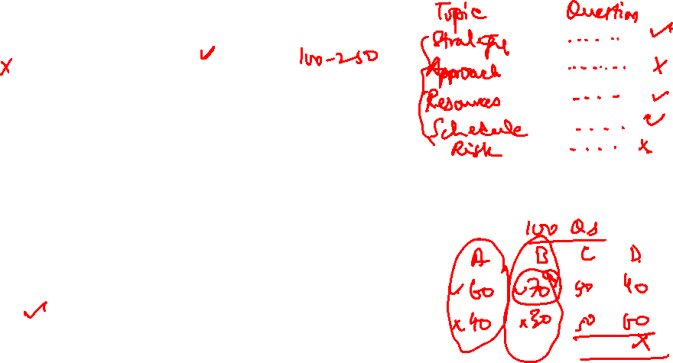
TWO MULTI-CRITERIA SELECTION MODELS
Checklist Models
  List of Questions to Review Potential Projects
  Determine Acceptance or Rejection
  Flexibility in Selecting Different Projects With Some Variations in Questions
  Fails to Answer the Relative Importance or Value of Potential Projects
  Fails to Allow Comparison With Other Potential Projects
  Room for Power Play, Politics, Manipulation
  Multi-Weighted Scoring Models

Slide 8
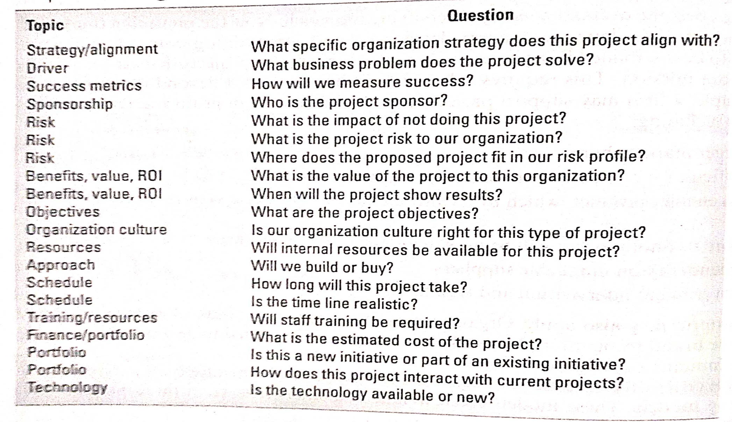


Slide 9

Non-Financial Criteria
  Multi-Weighted Scoring Models
CRITERION WEIGHTAGE
A. STAY WITH CORE COMPETENCIES 2.0
B. STRATEGIC FIT 3.0
C. URGENCY 2.0
D. 25% OF SALES FROM NEW PRODUCTS 2.5
E. REDUCE DEFECTS TO LESS THAN 1% 1.0
F. IMPROVE CUSTOMER LOYALTY 1.0
G. ROI OF 18% + 3.0

Slide 10
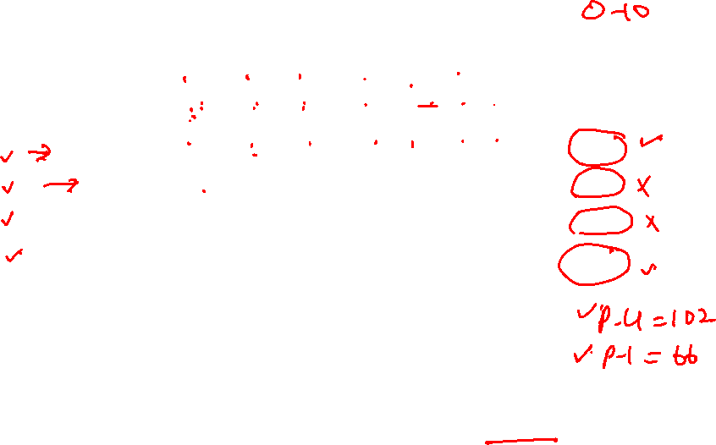
CONTRIBUTION VALUES TO EACH CRITERION FOR EACH PROJECT
Weightage 2 3 2 2.5 1 1 3
PROJECT A B C D E F G WT. TOTAL
1 1 8 2 6 0 6 5 66
2 3 3 2 0 0 5 1 27
3 3 0 10 0 0 6 0 32
4 1 10 5 10 0 8 9 102
Highest Priority: Project 4, then Project 1.
Projects Screened Out : Projects 2 and 3,
If criterion is; weighted total should be > 50.

Slide 11
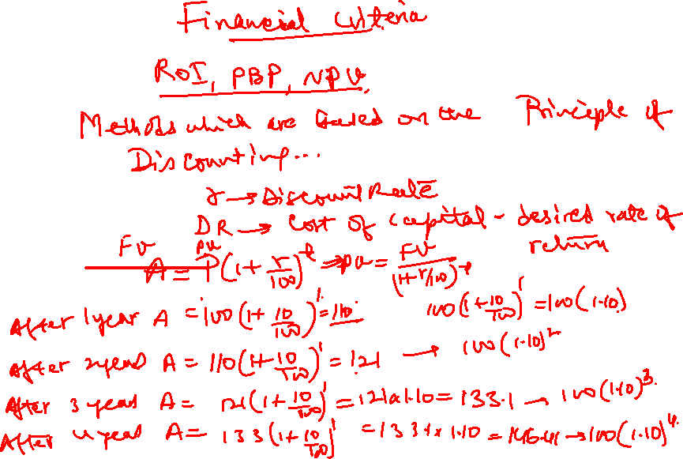


Slide 12
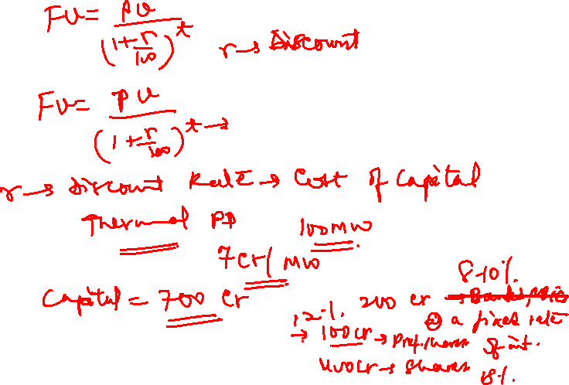

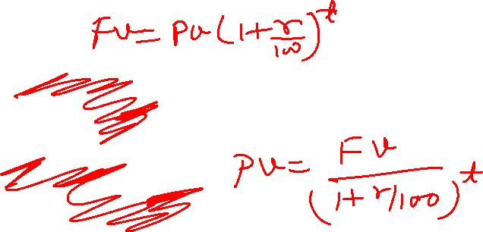


Slide 13
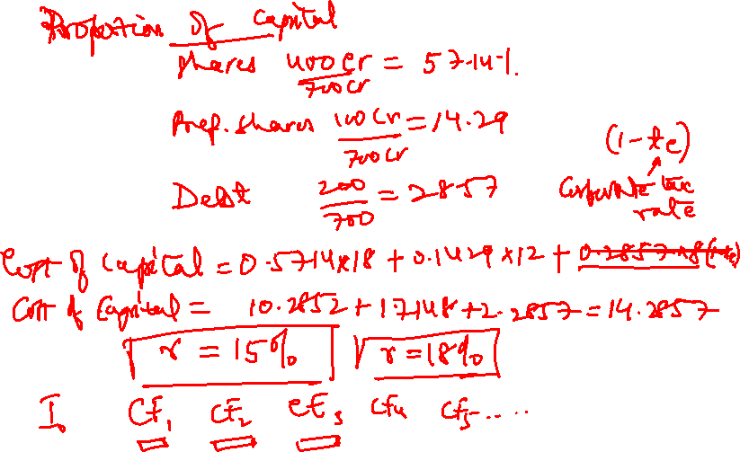
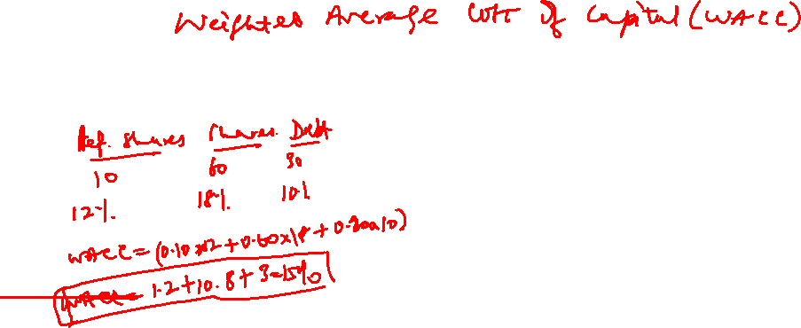

Slide 14

Project Operating Cash Flows
Estimate the operating capacity and corresponding sales for the future years from the project’s operation.
Work out the operating costs, which should include:
Direct material cost
Direct labour cost
Direct fuel or energy cost
Indirect material cost (spares and consumables for facilities)
Indirect labour cost (factory supervision, security, maintenance, quality control, warehouse or stores)
Other overheads (rent, utilities)

Slide 15

Project Operating Cash Flows
Admin costs (salary and facility operational costs in office)
Selling costs (packing, transportation, and distribution charges, sales commissions, advertising, salary of sales and marketing personnel)
3. Calculate interest and depreciation charges
4. Deduct the total operating costs (and depreciation and interest outgo) from the estimated sales to calculate the taxable income.
5. Work out tax on the taxable income and deduct it from the taxable income to calculate PAT.
6. Add back interest and depreciation to the profit after tax (PAT) to arrive at the profit before interest and depreciation but after taxes.

Slide 16
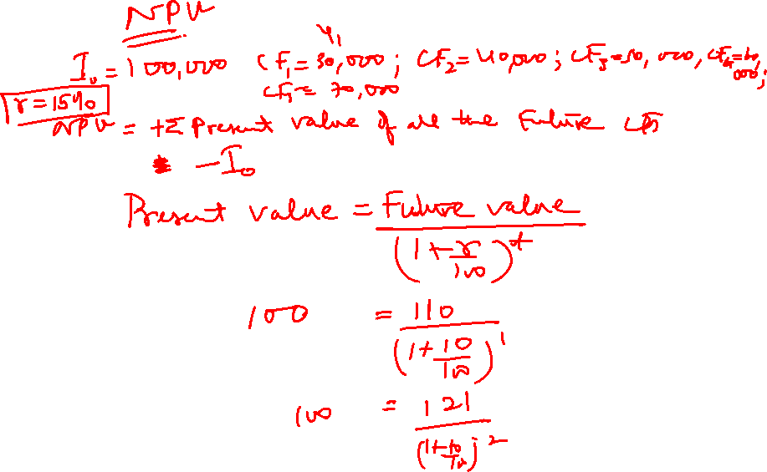

Slide 17
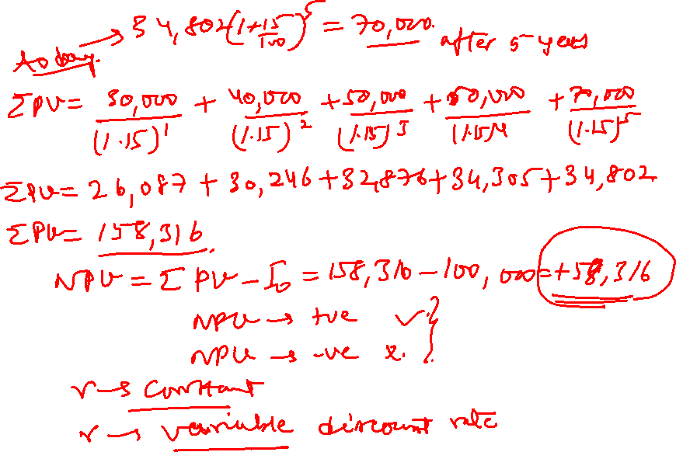

Slide 18
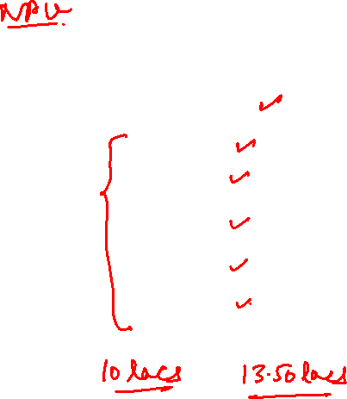
EXAMPLE 1
YEAR CASH FLOW
0 (-1,000,000)*
1 200,000
2 200,000
3 300,000
4 300,000
5 350,000
Discounting Rate = r = 10%
* Initial Investment (outflow)

Slide 19

Organization Strategy and Project Selection
NPV = - 1,000,000 + 200,000 + 200,000 +
(1.10)⁰ (1.10)¹ (1.10)²
(Initial Investment)
300,000 + 300,000 + 350,000
(1.10)³ (1.10)⁴ _{(1.10)5}
^{[(-1000000)} + (181818.18 + 165289.2562 + 225394.44
+ 204904.04 + 217322.46)]
^{= - Rs.} ^{5271.26}

Slide 20
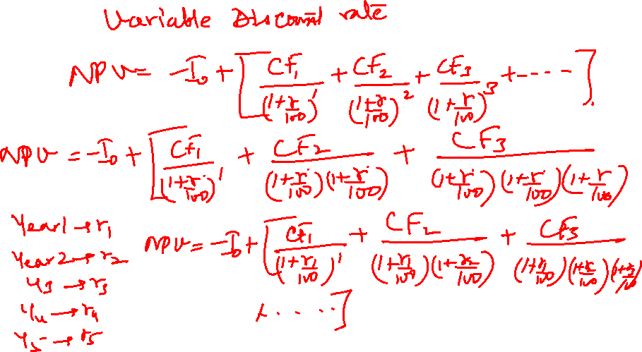

Slide 21
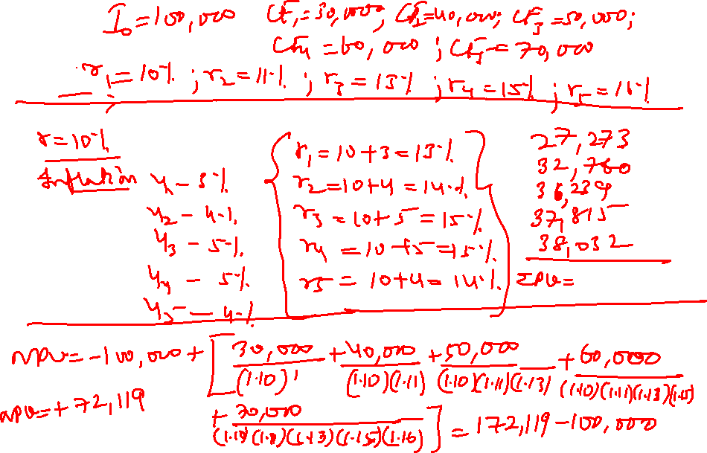

Slide 22
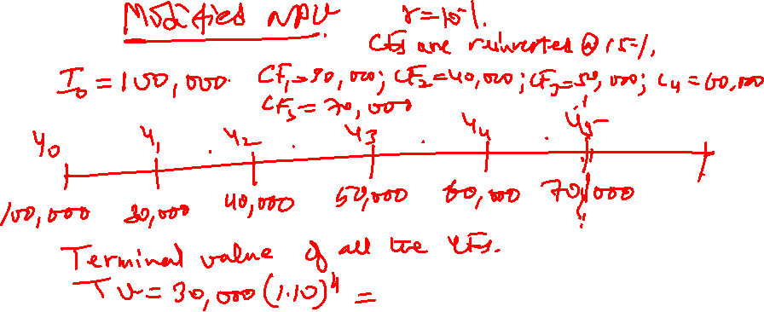

Slide 24
L-4: Project Selection
Thank You!

